Slide 1

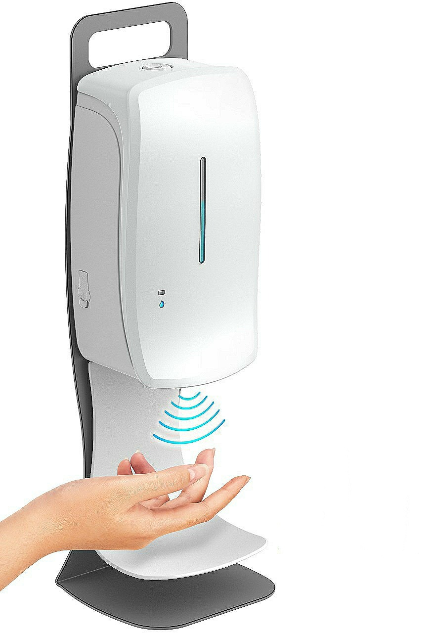

Sanitizer Vending Machine
Kshitiz – GEE/1840176
Amresh Kumar – GEC/1840073
Pravin Kumar – GEC/1840072
Siddharth Kumar – GWT/1840367
Dhanesh Kumar – GEC/1840061
Atish Deepankar (Team Co-ordinator, Student guide, GEC/2k16-2k20)
Kaushik Suman (Student guide, GEE/2k14-2k18)
Panikar (Student guide , GEC/2k16-2k20)
Dr. Anupama Marwaha (Faculty Advisor, Professor ECE Dept., SLIET)

Slide 2

Contents
01. | SVM (Sanitizer Vending Machine)
02. | PIR Sensor and its interfacing with Arduino & Mist Atomizer and its alternative
03. | Mist Atomizer and its Mechanism
04. | Circuit Diagram of Mist Atomizer
05. | Designing of SVM
06. | Novelty and Utility of SVM
07. | Market Potential
08. | What next or Future Upgradations
09. | Industry in Institute
10. | Any Query?

Slide 3
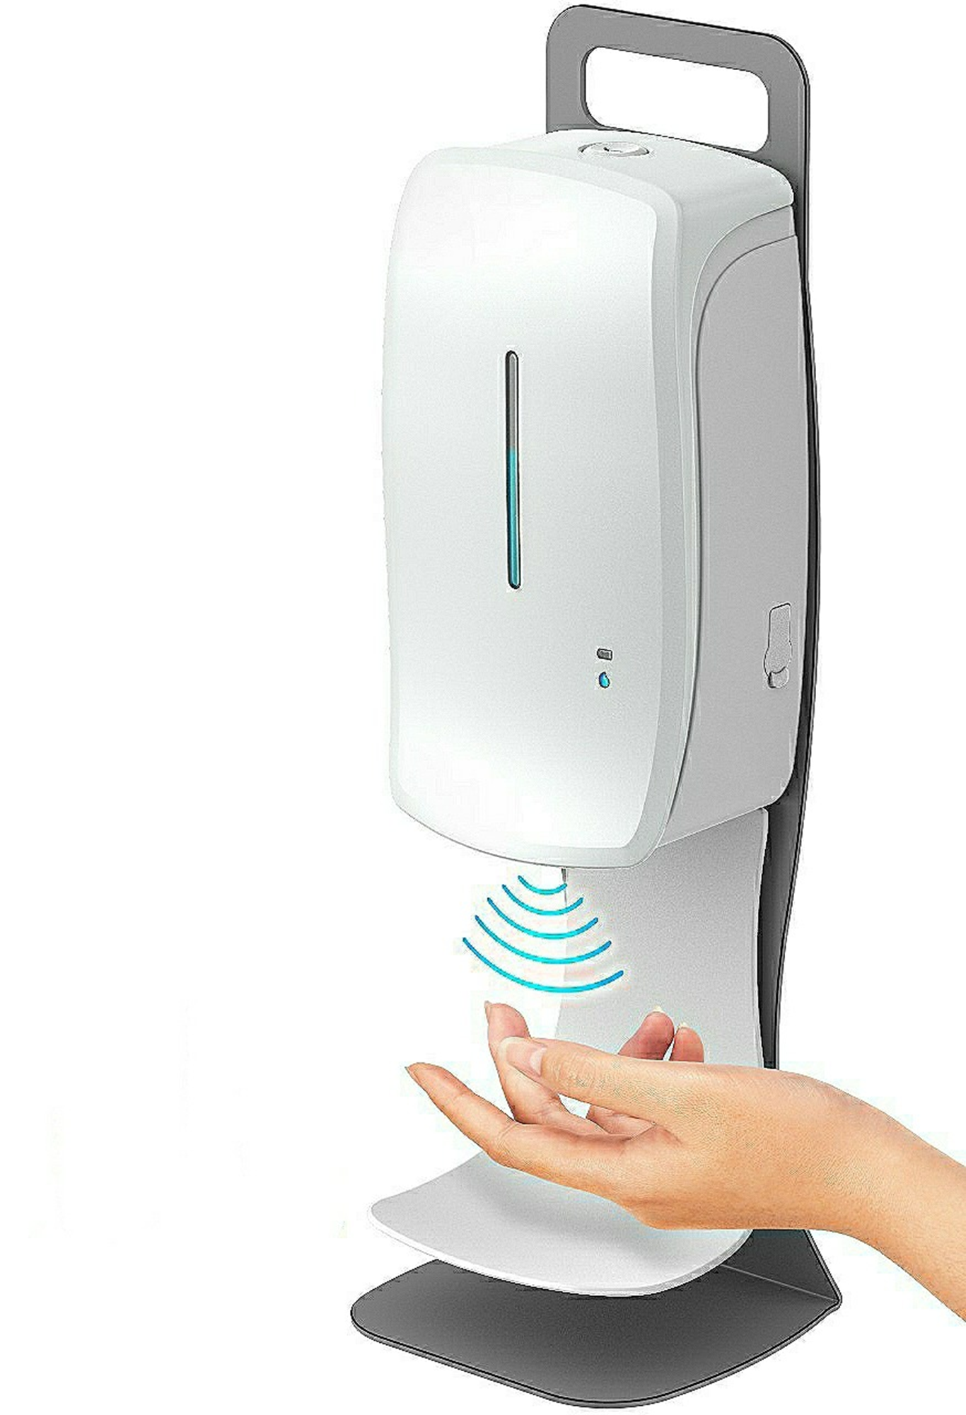
SVM (Sanitizer Vending Machine)
The Sanitizer Vending Machine is an automatic sanitizer dispenser machine.
It is a touchless machine, which is used to reduce the risk of contact with SVM.
The touchless mechanism is completely based on Infrared sensing for dispensing sanitizer using PIR Sensor.
It also saves sanitizer through mist mechanism.
It can also be booted by mobile phones.
The Components used in SVM are PIR Sensor, Arduino Board, Li-Po Battery (12V), Mist Atomizer, Wi-Fi Module and Container.

Slide 4
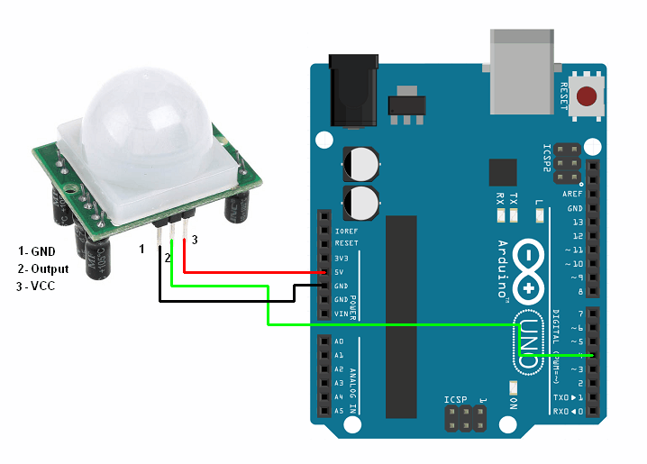
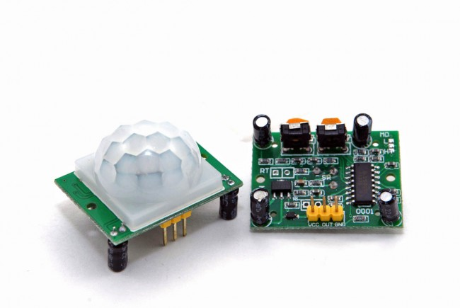
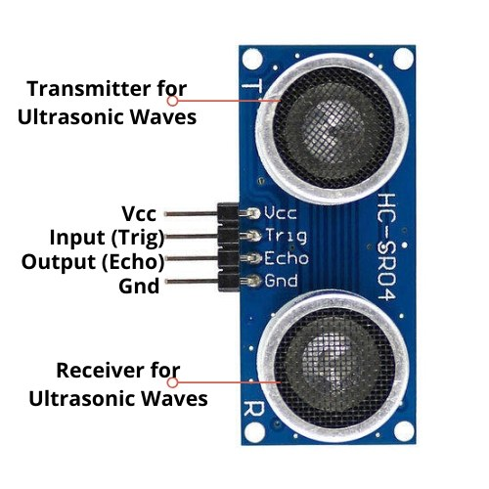
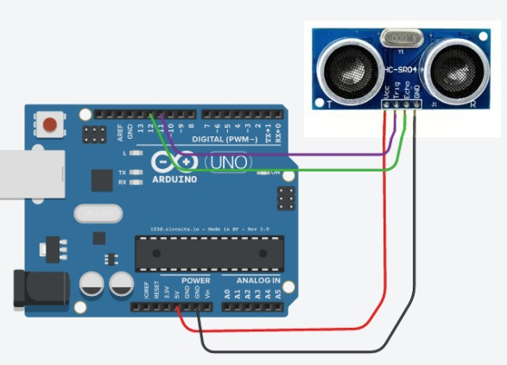
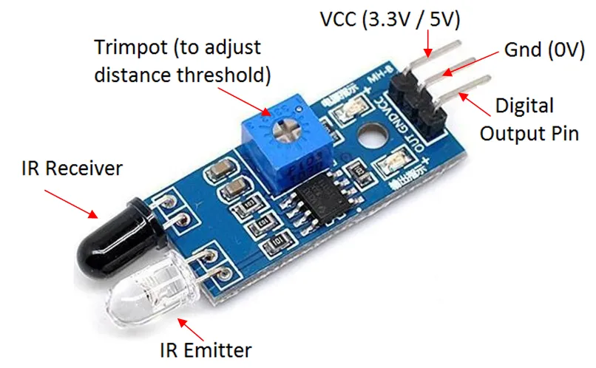
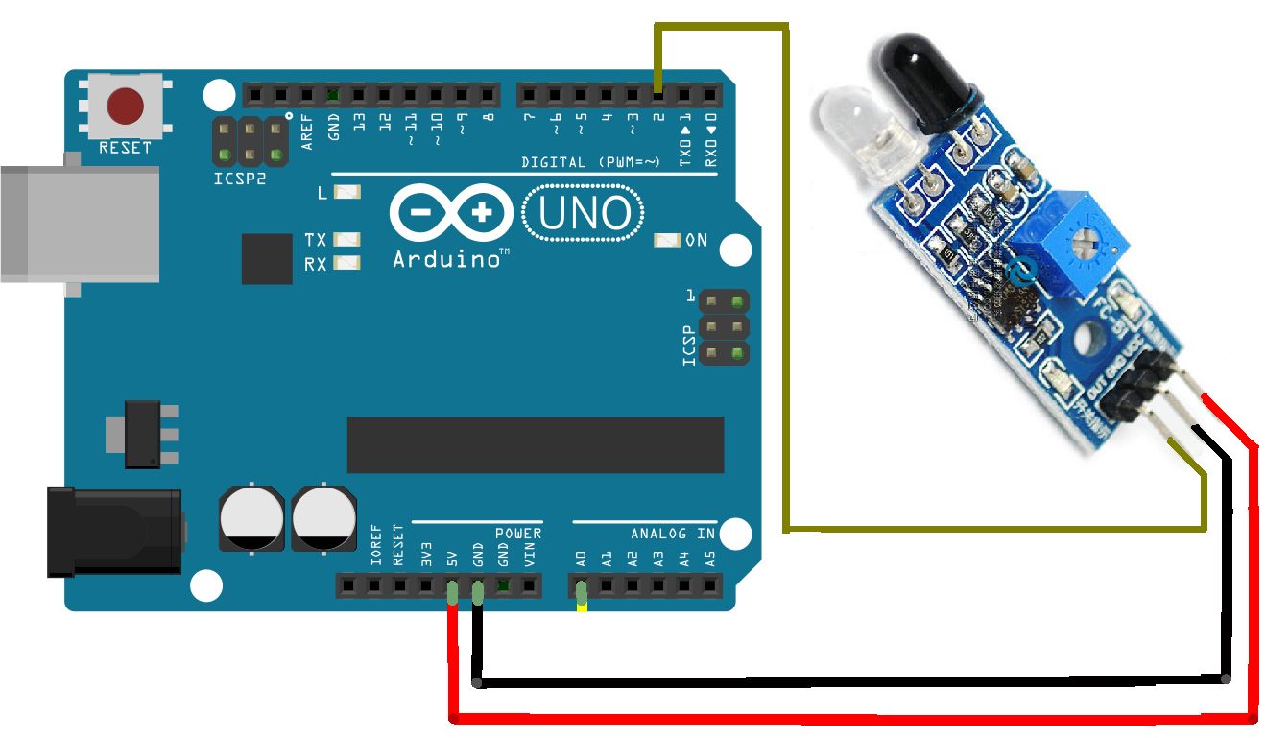
PIR Sensor
It stands for passive infrared sensor (PIR) i.e. measures the difference of Infrared Radiations.
It detects the moving object which emits IR Radiations.
It operates on D.C. 5V & gives output up to 3.4V.
PIR Interfacing with Arduino & Atomizer
PIR has three pins VCC (Connected to 5V Arduino port), OUT (Input of Mist Atomizer), GND(connected to GND of Arduino Port).
The positive terminal of the Atomizer is connected to output of PIR Sensor and the negative is connected with the GND of Arduino.
Alternative of PIR Sensor
IR Sensor (Infrared Sensor)
Ultrasonic Sensor

Slide 5
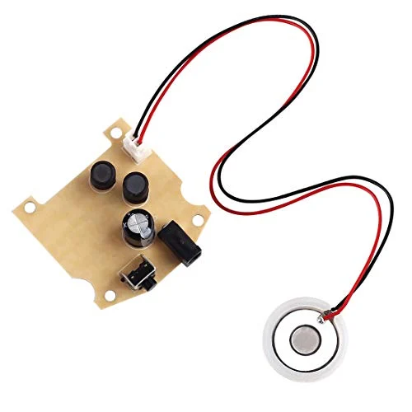
Mist Atomizer
The main purpose for using mist atomizer is to save sanitizer by making fog.
This is 5V DC Ultrasonic Humidifiers Power Circuit Board with Atomizing Chip Moisture Film Humidification atomization machine .
This Ultrasonic Humidifier Piezoelectric Transmitter module works on the principle of cavitations produced by sound waves.
Just providing the DC (3-12)V power supply it will turn into a mini ultrasonic atomizer.

Slide 6
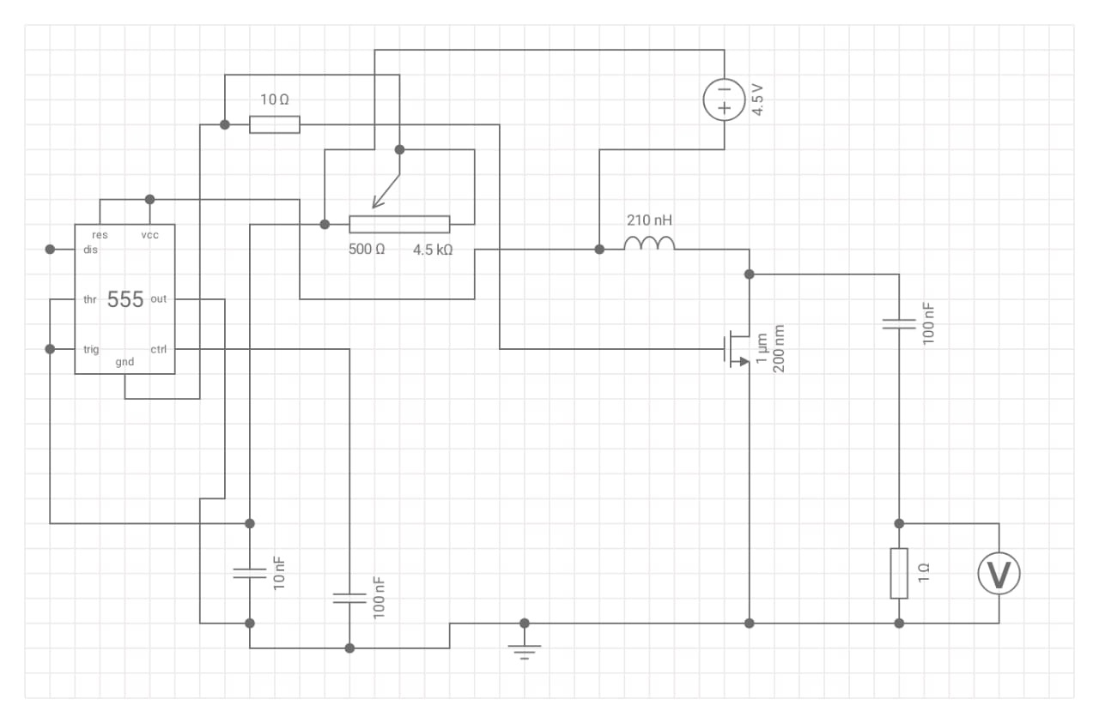
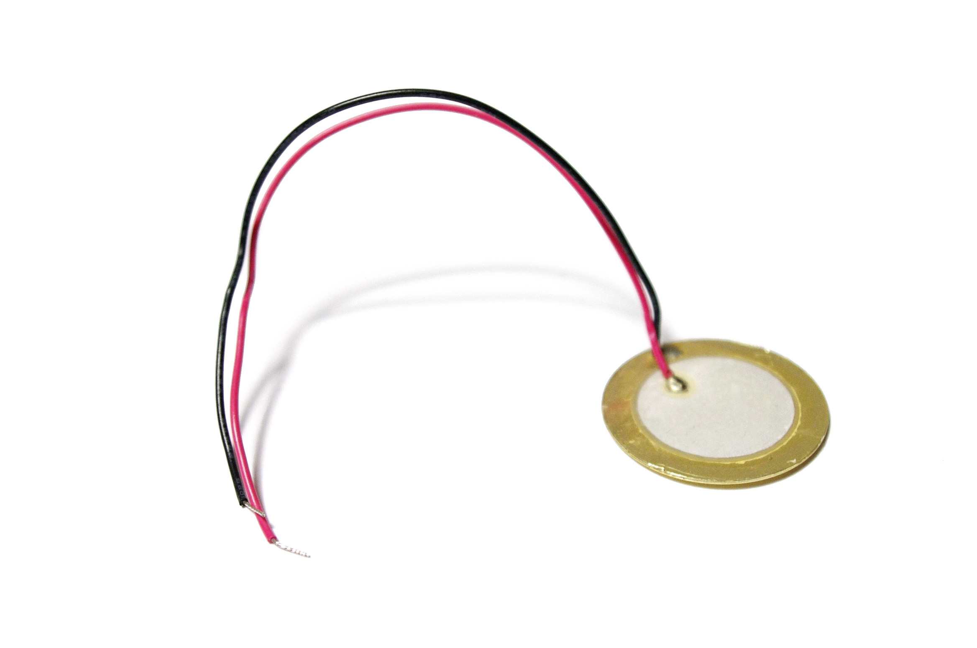
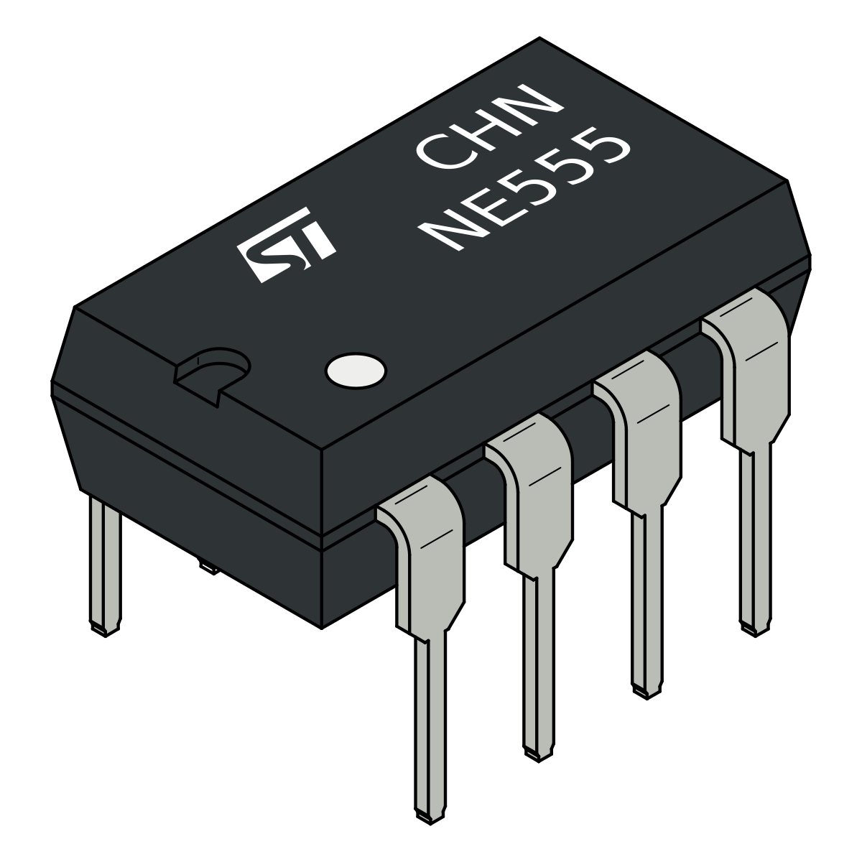
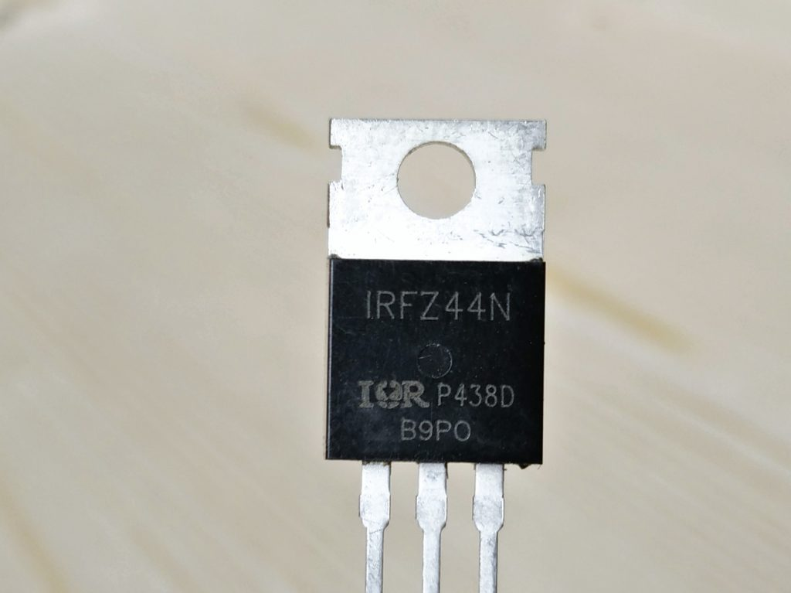
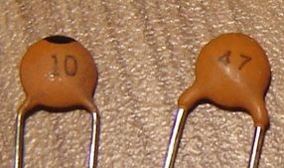
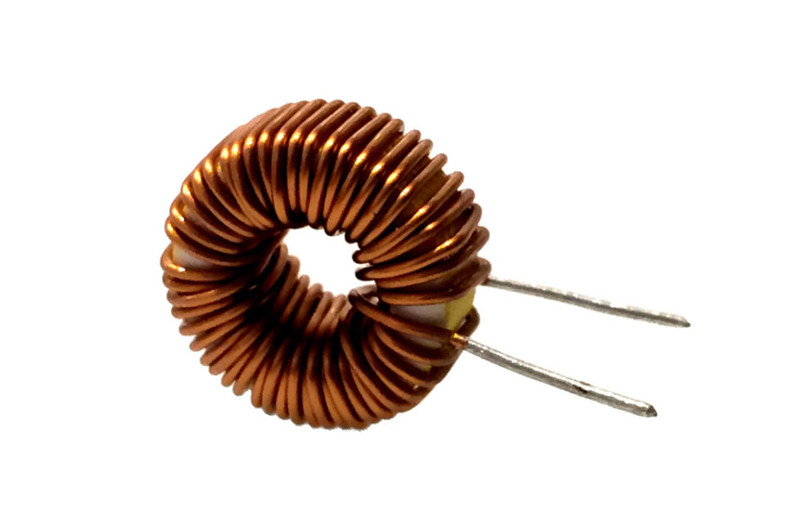
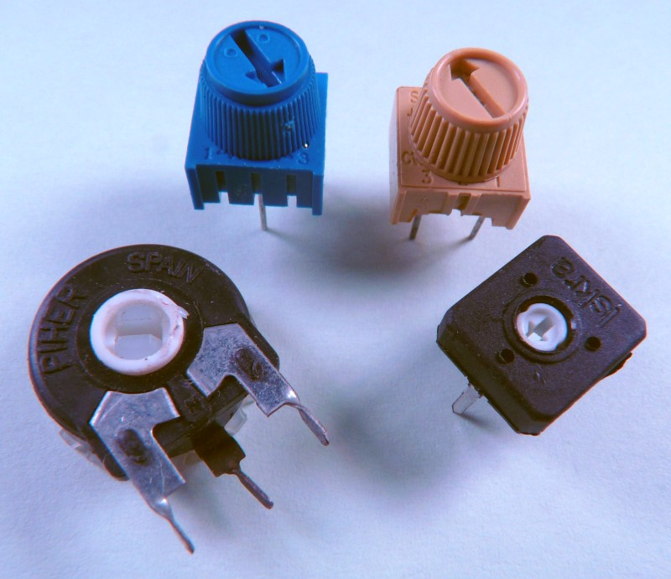
Circuit diagram of Mist Atomizer
COMPONENTS USED
PIEZOELECTRIC DISK
IC NE555
IRF Z44 MOSFET
10 NANO-FARAD CAPACITORS
100 NANA-FARAD CAPACITORS
220 MICRO-HENRY INDUCTOR
5K VARIABLE RESISTORS

Slide 7
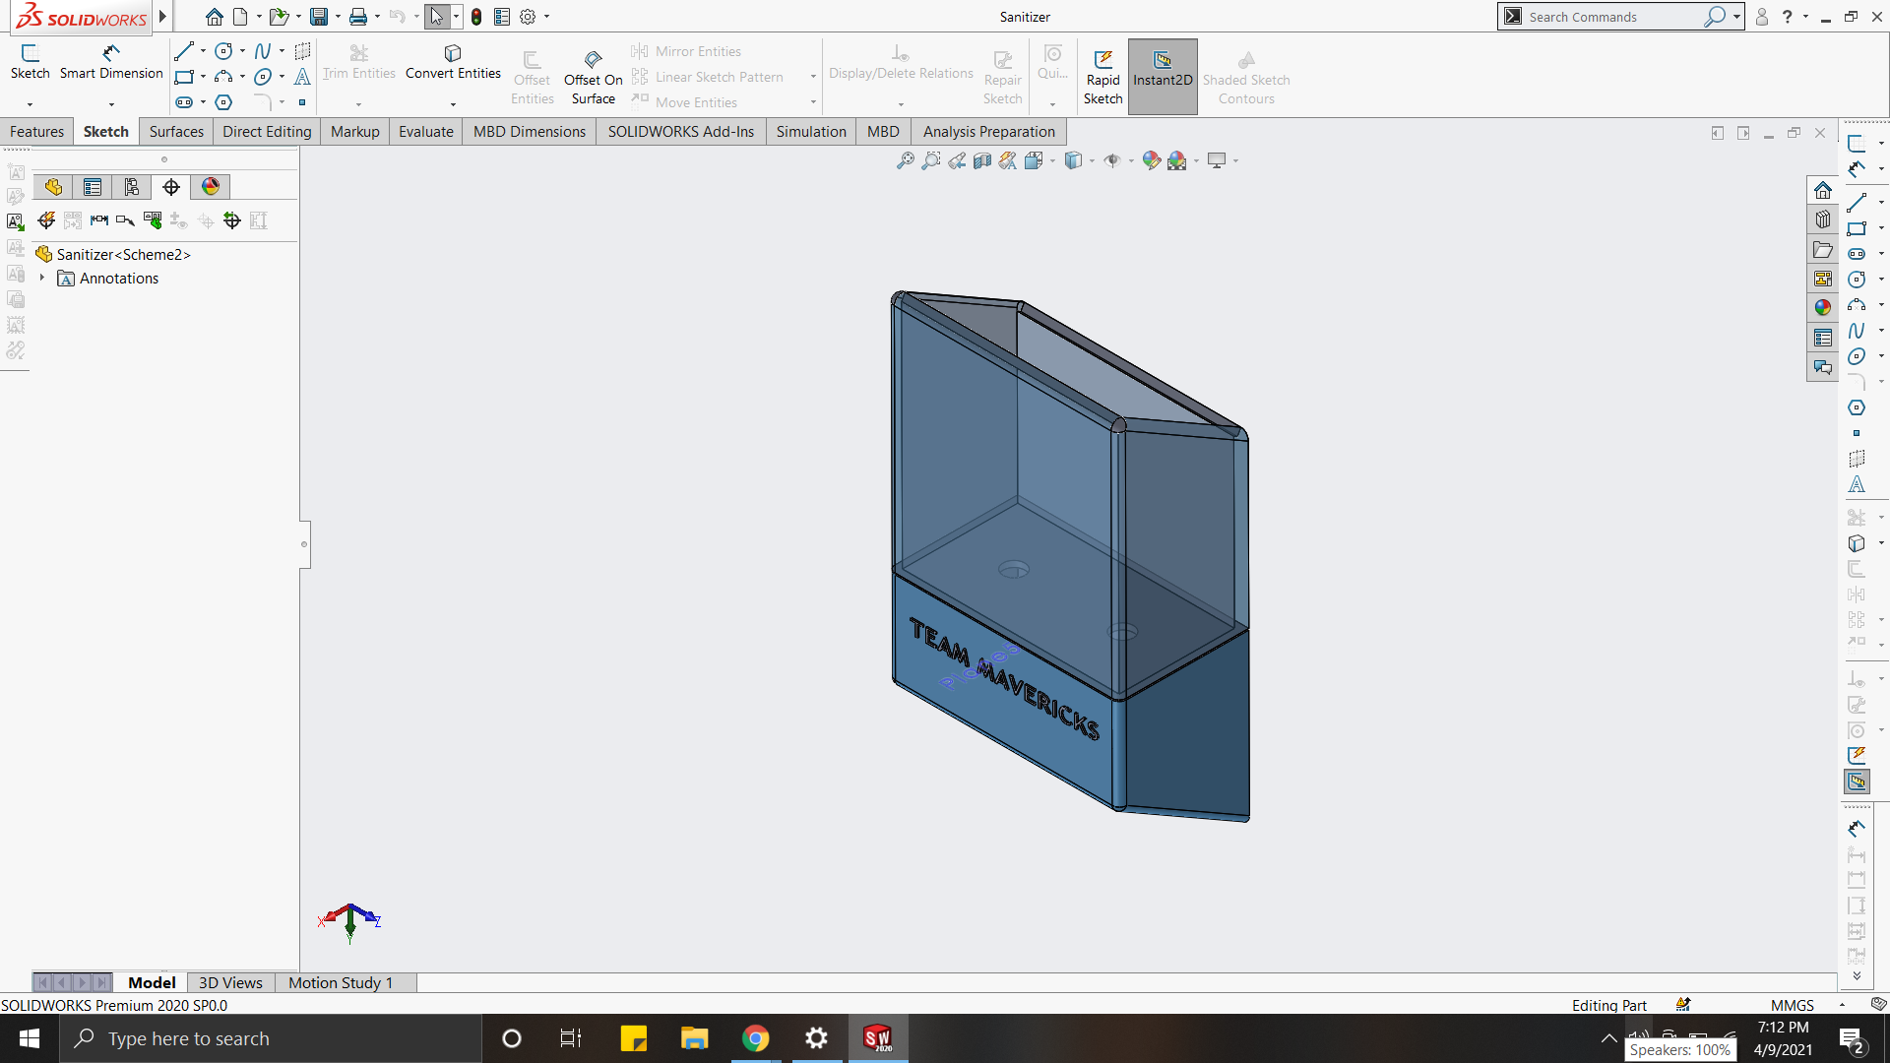
Designing of SVM
A unique and highly functional design by keeping two sections separate where one induces the role for keeping the liquid i.e., sanitizer liquid and the other one for electronics

Slide 8
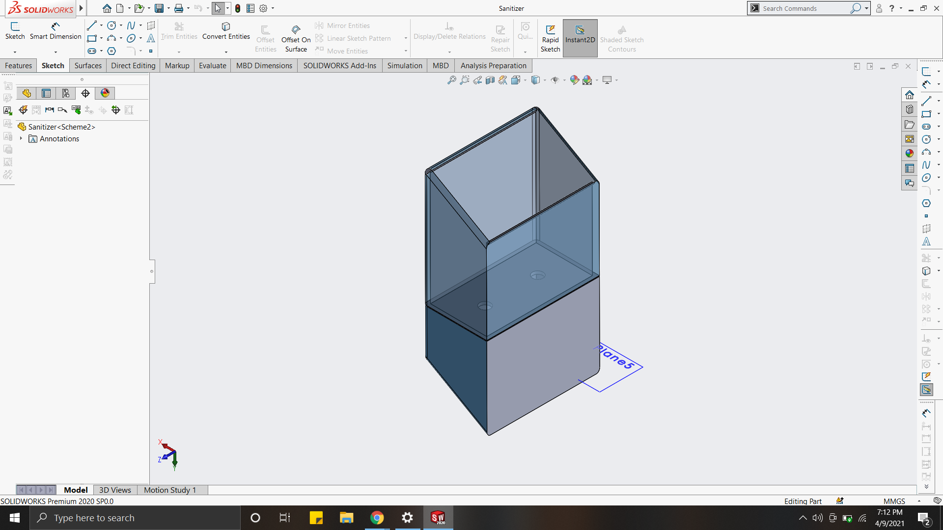
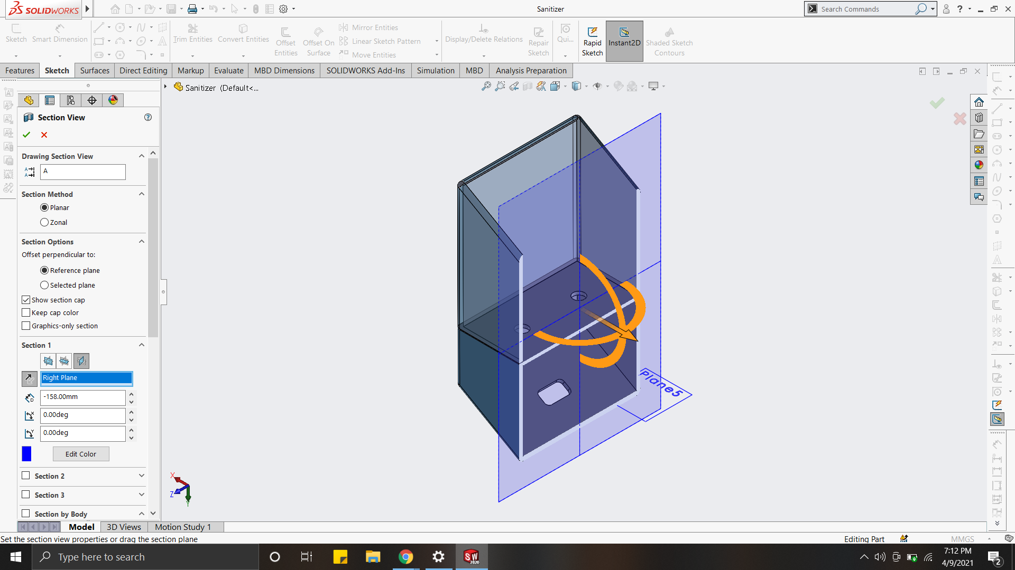
Why two sections ?
In this integrated design you can fill directly 2 sanitizer bottle with standard size cap
Or you can directly fill it by pouring the liquid sanitizer

Slide 9
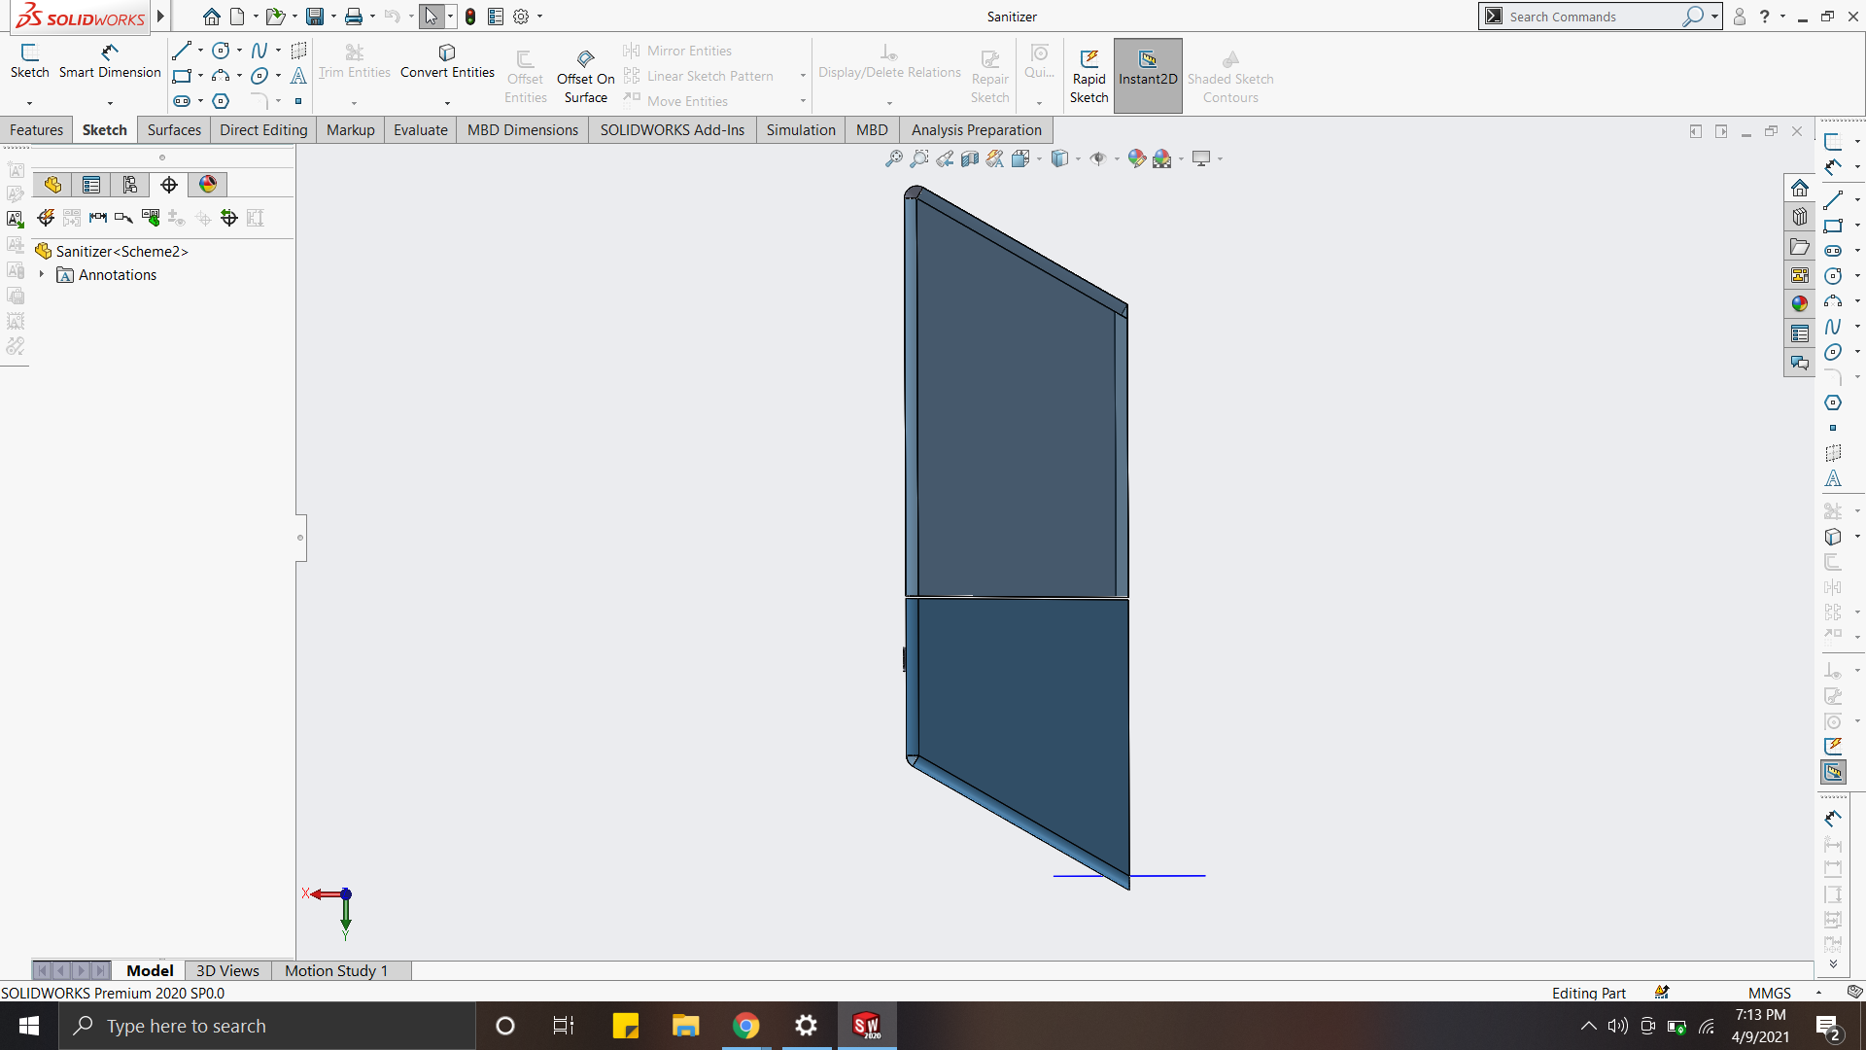
Why Keep it at 45° tilted not Rectangular ?
By keeping it at 45° the user can easily target there hand in front of the sanitizer and can use it
The second advantage is of the aesthetics it looks sharp.

Slide 10
Novelty and Utility of SVM
Novelty
Utility
Our Vending Machine is small in size and compact due to which weight is less.
Our SVM work on Li-Po Battery which is completely DC and does not take power from AC Power Source.
It can save 90% of the Sanitizer and only use 10% sanitizer for sanitization purpose as compared to drop dispenser.
It also provide touchless starting due to use of Wi-Fi Module.
It can be installed vary easily at any place and easy to transport from one place to another place.
This machine is durable, compact in size and easy to operate as compared to market SVM.
It is used in small scale utility in for home purposes, self utility purposes, small office, etc.
In large scale utility, it can be used in Cinema Halls, Shopping Complex/Malls, Voting Center, Railway Stations, Police Stations, Industries, Companies, etc.

Slide 11

Market Potential
All the SVM used in public places are working on AC supply, and we all know that corona is not dependent of electricity. So, we have to use that type of SVM which is 24*7 available .
We will work on fully touchless SVM which is not available on market, even power button is also controlled by smart gadgets like smart phones.
The main thing is price for any product to be in market .so, we want to introduce that not even a single company provide the same feature in our project budget.
NOT even a single report shows decrementation in market value of SVM in next 5-10 years..!!!

Slide 12

year | Market value | CAGR
2019 | $2.2 Billion | 95
2025 | Upto $5.5 Billion | 88
CAGR | 17.0% | 90
GROWTH RATE
From our aspects ,the market potential of our product is very high as compared to many.
Our thinking is that we keep our product not up to project level only but
want to introduce in market as soon as possible.

Slide 13
What Next or future upgradations
In Future, we are planning to add Microbes scanner to the SVM for the detection of Microbes (Bacteria, Viruses, etc.).
We are planning to add advanced form of Sanitizer Tank, which is basically capable to make sanitizer by itself.
We are also planning to add an air purifier to the SVM, which generally purify the air inside the room where SVM is put inside.

Slide 14

Industry in Institute
“Every Institute should have student workforce to yield at least a mini market potential with the help of pursuing students or Alumni to enforce a startup or providing raw workforce/services to any corporation or industry”.
- Atish Deepankar

Slide 15
Thank You
Any Query?

